Slide 1
The SAGA C++ Reference Implementation
Lessons Learnt from Juggling with Seemingly Contradictory Goals
Hartmut Kaiser, Andre Merzky, Stephan Hirmer, Gabrielle Allen

Slide 2
Roadmap
What is SAGA, why do we think, we need it?
  Why another Grid API
  Realities of Grids
  Simple API for grid Applications
Requirements
Architecture
Lessons learnt
Code examples

Slide 3
Simple API for Grid Applications
OGF standardization effort
  Intends to simplify the development of grid-enabled applications by standardizing syntax and semantics of a Grid API
  Even for scientists with no background in computer science, or grid computing
  Interesting, challenging problem due to dynamic environment of today’s Grids
  80/20 rule: maximal abstraction for minimal programming effort for the user
Simple and Standard are the keywords

Slide 4
Why another Grid API?
The situation today:
Grids: everywhere
        Well, supposedly. At least many projects ☺
Grid applications: nowhere
        Almost. At least our in experience that this is difficult
Why is this?
Application programmers accept the Grid as a computing paradigm only very slowly.
Problems: (multifold and often cited - amongst others)
  Interfaces are not simple (see next slides. . .)
        Typical Globus code... ahem... ☺
  Different and evolving interfaces to the ’Grid’
        Versions, new services, new implementations, WSDL or WSRF do not solve all problems at all
  Environment changes in many ways
        Globus, grid members, services, network, applications, ...

Slide 5
Copy a File: Globus GASS
int copy_file (char const* source, char const* target) { globus_url_t source_url; globus_io_handle_t dest_io_handle; globus_ftp_client_operationattr_t source_ftp_attr; globus_result_t result; globus_gass_transfer_requestattr_t source_gass_attr; globus_gass_copy_attr_t source_gass_copy_attr; globus_gass_copy_handle_t gass_copy_handle; globus_gass_copy_handleattr_t gass_copy_handleattr; globus_ftp_client_handleattr_t ftp_handleattr; globus_io_attr_t io_attr; int output_file = -1; if ( globus_url_parse (source_URL, &source_url) != GLOBUS_SUCCESS ) { printf ("can not parse source_URL \"%s\"\n", source_URL); return (-1); } if ( source_url.scheme_type != GLOBUS_URL_SCHEME_GSIFTP && source_url.scheme_type != GLOBUS_URL_SCHEME_FTP && source_url.scheme_type != GLOBUS_URL_SCHEME_HTTP && source_url.scheme_type != GLOBUS_URL_SCHEME_HTTPS ) { printf ("can not copy from %s - wrong prot\n", source_URL); return (-1); } globus_gass_copy_handleattr_init (&gass_copy_handleattr); globus_gass_copy_attr_init (&source_gass_copy_attr); globus_ftp_client_handleattr_init (&ftp_handleattr); globus_io_fileattr_init (&io_attr); globus_gass_copy_attr_set_io (&source_gass_copy_attr, &io_attr); &io_attr); globus_gass_copy_handleattr_set_ftp_attr (&gass_copy_handleattr, &ftp_handleattr); globus_gass_copy_handle_init (&gass_copy_handle, &gass_copy_handleattr); | if (source_url.scheme_type == GLOBUS_URL_SCHEME_GSIFTP || source_url.scheme_type == GLOBUS_URL_SCHEME_FTP ) { globus_ftp_client_operationattr_init (&source_ftp_attr); globus_gass_copy_attr_set_ftp (&source_gass_copy_attr, &source_ftp_attr); } else { globus_gass_transfer_requestattr_init (&source_gass_attr, source_url.scheme); globus_gass_copy_attr_set_gass(&source_gass_copy_attr, &source_gass_attr); } output_file = globus_libc_open ((char*) target, O_WRONLY | O_TRUNC | O_CREAT, S_IRUSR | S_IWUSR | S_IRGRP | S_IWGRP); if ( output_file == -1 ) { printf ("could not open the file \"%s\"\n", target); return (-1); } /* convert stdout to be a globus_io_handle */ if ( globus_io_file_posix_convert (output_file, 0, &dest_io_handle) != GLOBUS_SUCCESS) { printf ("Error converting the file handle\n"); return (-1); } result = globus_gass_copy_register_url_to_handle ( &gass_copy_handle, (char*)source_URL, &source_gass_copy_attr, &dest_io_handle, my_callback, NULL); if ( result != GLOBUS_SUCCESS ) { printf ("error: %s\n", globus_object_printable_to_string (globus_error_get (result))); return (-1); } globus_url_destroy (&source_url); return (0); }

Slide 6
Copy a File: SAGA
#include <string>
#include <saga/saga.hpp>
void copy_file(std::string source_url, std::string target_url)
{
try {
saga::file f(source_url);
f.copy(target_url);
}
catch (saga::exception const &e) {
std::cerr << e.what() << std::endl;
}
}
Provides a standardized high level abstraction layer
Uses well known paradigms
Shields programmers from idiocynchracies of Grids
Blends well with existing language features and libraries

Slide 7
Realities of Grids
Different hardware
  Chipset
  Architecture (desktops, beowulf clusters, SMP, etc.)
Different software
  Operating system, compilers
  Libraries, software stack
  Middleware service versions
Different administrative policies
  Access policies, quotas, upgrade policies
Highly dynamic at all levels
  without notifying you as the user

Slide 8
Requirements
Provide ‘Simple’ and ‘Easy-to-Use’ API
Cope with evolving Standards landscape and future extensions
        OGF Standards are emerging, 5-10 years timeframe until stabilized
Shield from middleware evolution
        Research projects, bad backwards compatibility
Provide fail safety and hide dynamics
        Heterogenious Grid environments
Portability, platform independence
        Distributed applications
Easy to deploy, configure, and maintain
        No. 1 end user requirements
Provide consistent language bindings
        No templates, as close to the spec as possible

Slide 9
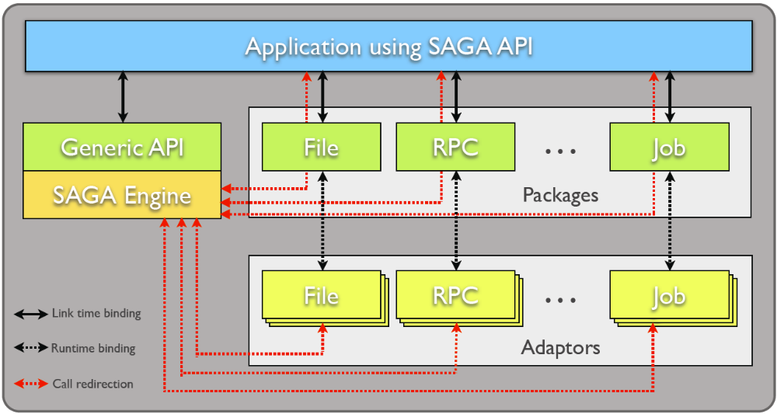
Architecture Overview

Slide 10
Extensibility
Horizontal Extensibility – API Packages
  Current packages:
    file management, job management, remote procedure calls, replica management, data streaming, etc.
Vertical Extensibility – Middleware Bindings
  Different adaptors for different middleware
  Set of ‘local’ adaptors
Extensibility for Optimization and Features
  Bulk optimization, modular design

Slide 11
Lessons learnt
Macros are not (always) evil
PImpl idiom useful even in complex object hierarchies
Futures/tasks make it easy to implement asynchronous API’s
Polymorphism is your friend
Grid environments allow for fancy implementations

Slide 12
Macros are not (always) evil
Every API function in 4 different flavors: 2 synchronous, 2 asynchronous
        Error prone, boring, makes writing new packages a nightmare
Macros expand to set of functions
  Type safety not sacrificed
Partial macro expansion (Boost.Wave)
  Well, generating partial output
  No debug problems
Simplifies writing of new packages

Slide 13
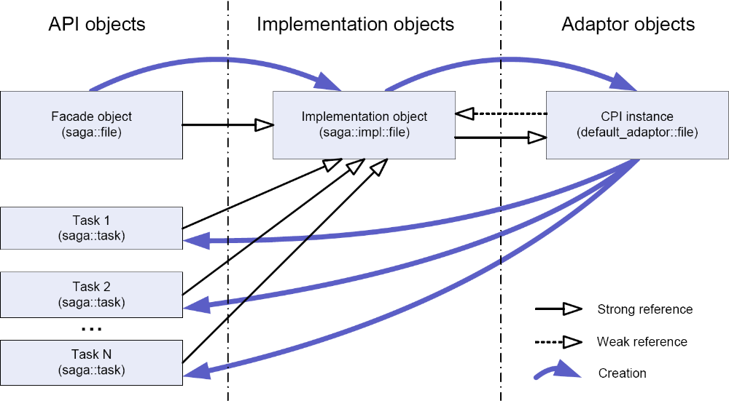
PImpl idiom

Slide 14
PImpl idiom
Simple – not only the API but usage as well
  Lightweight objects, well blending with existing libraries (STL, Boost, etc.)
  Avoid object slicing while providing required object hierarchy
  No need to worry about object lifetimes or memory management
Decouple API and implementation
Allow straightforward implementation of asynchronous operations (tasks)
Tasks are implemented on top of futures
  Very nice concept, enables simple implementation of fully concurrent and asynchronous API, ensures correct exception handling

Slide 15
Polymorphism
Combination of run time and compile time polymorphism
  I.e. virtual functions (abstract base classes) and templates (code reuse, meta-programming)
  Run time polymorphism is used to abstract different implementations
  Compile time polymorphism is used to avoid same code over and over again

Slide 16
Fancy implementations
Latencies are major contributor to wall time needed to execute Grid related operations
Fancy implementations, providing
  Fallback solutions
  Sophisticated error handling and fail proof implementations
These are not only necessary in Grid related scenarios, but also possible

Slide 17
Example: Task model
file f ("any://host.net//data/src.dat");
// normal sync version of the copy method
f.copy ("any://host.net//data/dest1.dat");
// the three task versions of the same method
task t1 = f.copy <task::Sync> ("any://host.net//data/dest2.dat");
task t2 = f.copy <task::ASync> ("any://host.net//data/dest3.dat");
task t3 = f.copy <task::Task> ("any://host.net//data/dest4.dat");
// task states of the returned saga::task
// t1 is in ’Finished’ or ’Failed’ state
// t2 is in ’Running’ state
// t3 is in ’New’ state
t3.run ();
t2.wait ();
t3.wait ();

Slide 18
Example: Bulk optimization
std::vector<std::string> files = ...initialize with list of url’s...;
saga::task_container tc;
// create file copy tasks
for (std::vector<std::string>::size_type i = 0; i < files.size(); ++i)
{
saga::file f (files[i]);
tc.add (f.copy<saga::Task>(...destination url...));
}
// run all tasks, then wait for all
saga::run_wait(tc); // bulk optimization is applied here.

Slide 19
Conclusions
SAGA is a very high abstraction level of Grids using well known programming paradigms
Libraries are a means of securing investment into the future
Presented a generic framework for building libraries allowing runtime dispatching to different implementations of similar functionalities

